Slide 1


ClassConnect: Revolutionizing Virtual Learning
ClassConnect is an innovative AI-driven virtual classroom solution. It aims to enhance student engagement and provide personalized learning experiences. Developed by Group 2nd year Computer Engineering students at AIKTC New Panvel.

Slide 2

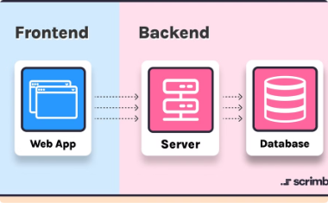


Meet the Team
Alamin Mondal (23CO50)
Khan Abdul Haddi (23CO34)
Shaikh Nashra Mohd Wahid (23CO14)
Kazi Jishan Nasir (23CO32)
Front-end development lead. Expert in creating intuitive user interfaces.
Back-end architecture specialist. Ensures robust server-side functionality.
AI integration expert. Implements cutting-edge machine learning models.
Quality assurance lead. Ensures seamless user experience and system reliability.

Slide 3
Introduction to ClassConnect
Current Challenges
Our Solution
Students and educators face engagement issues in virtual environments. Existing platforms lack interactivity and personalization.
ClassConnect enhances engagement through AI-powered personalization. It creates an interactive, tailored learning experience for each student.

Slide 4
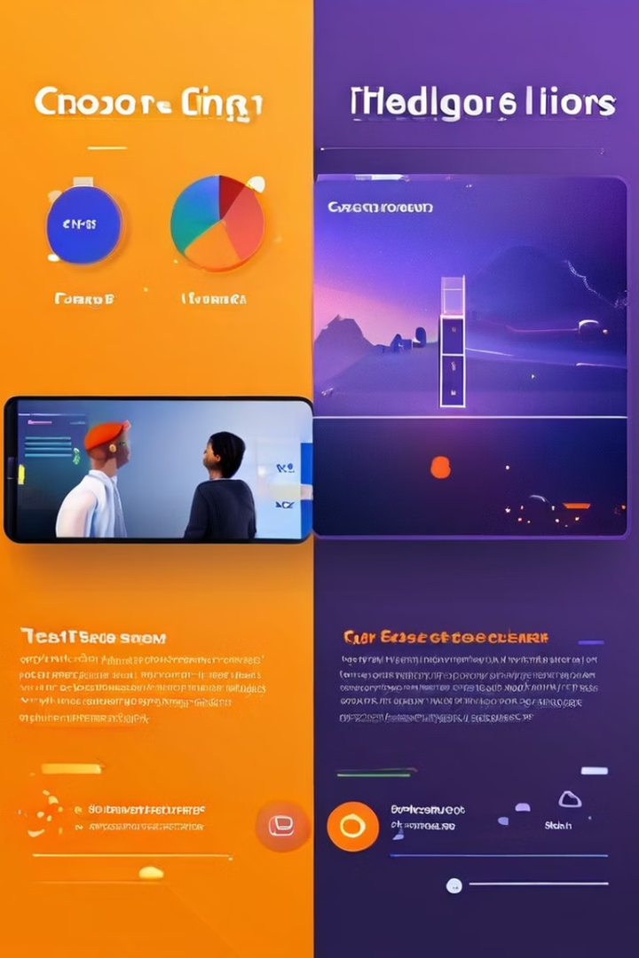
Market Analysis
1
Current Platforms
Google Classroom, Microsoft Teams, and Zoom dominate. They offer basic virtual classroom functionality but lack advanced engagement features.
2
User Feedback
Users report low engagement and lack of personalization. There's a growing demand for more interactive, AI-driven solutions.
3
Market Gap
An opportunity exists for a platform that integrates communication, learning management, and AI-powered engagement tools.

Slide 5

Proposed Methodology
Objective
Develop a comprehensive solution integrating communication, learning management, and advanced AI features.
Front-End
Utilize HTML, CSS, and JavaScript to create a responsive, intuitive interface.
Back-End
Implement robust server-side functionality using Node.js and PHP for scalability.

Slide 6

Front-End Development
1
Design Theme
2
User Interface
3
Key Features
Light mint color scheme with smooth transitions for a fresh, engaging look.
Intuitive navigation and clear layout to enhance user experience across devices.
Course navigation, progress tracking, and real-time notification system integrated seamlessly.

Slide 7




Back-End Architecture
Server Integration
Data Management
AI Integration
Node.js and PHP combine for a scalable, robust backend infrastructure.
Efficient handling of user data, course content, and real-time interactions.
Implementation of AI models for attention monitoring and personalized feedback.

Slide 8




AI-Driven Features
Attention Tracking
AI models monitor student focus in real-time, providing instant engagement feedback.
Personalized Learning
AI tailors content and pacing based on individual student data and learning patterns.
Analytics
Comprehensive insights on student performance and engagement for educators.

Slide 9

Competitive Advantage
Feature
ClassConnect
Competitors
AI-Driven Engagement
Advanced
Basic/None
Personalized Learning
Comprehensive
Limited
Real-Time Feedback
Instant
Delayed/Manual
Integration
All-in-One
Fragmented

Slide 10

Future Development
1
Short-Term
Implement gamification features and advanced analytics for deeper insights.
2
Mid-Term
Integrate AR/VR technologies for immersive learning experiences.
3
Long-Term
Position ClassConnect as the global standard for AI-driven virtual learning.

Slide 11
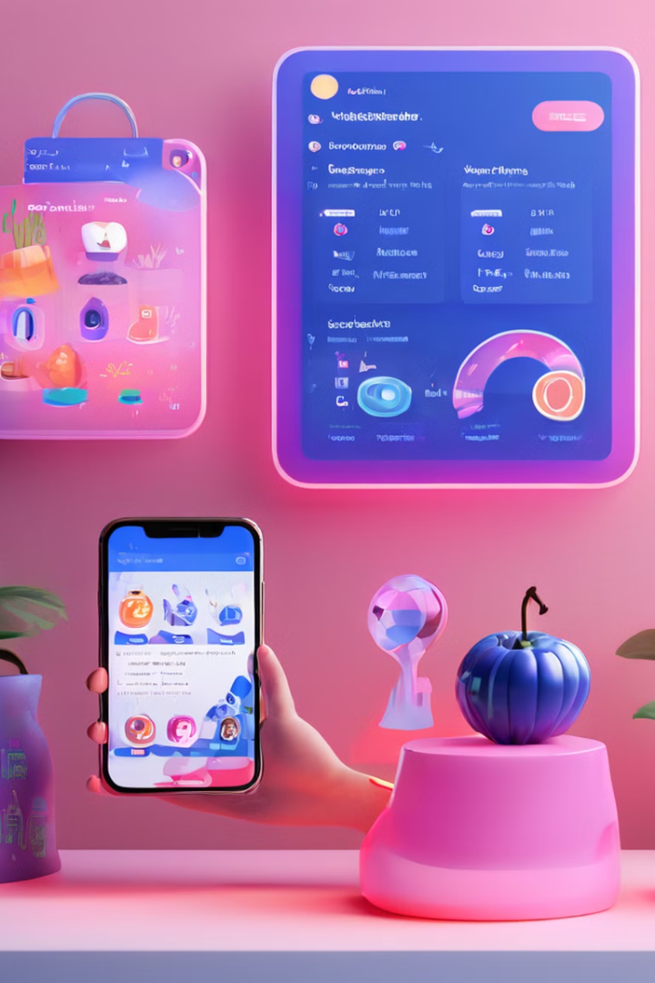
Survey of Existing Solutions
Platform
Strengths
Gaps
Google Classroom
Basic learning management
Limited AI integration
Microsoft Teams
Robust communication
Lack of personalized engagement
Zoom
Video conferencing
Limited learning management
ClassConnect
AI-driven engagement
Comprehensive solution

Slide 12

User Feedback and Challenges
1
Limited Engagement Tools
Users report difficulty in maintaining student focus during online sessions.
2
Insufficient Personalized Feedback
Current platforms lack mechanisms for providing timely, individualized feedback to students.
3
Real-time Progress Tracking
Educators struggle to monitor student progress effectively in virtual environments.

Slide 13

Proposed Methodology
1
Front-End Development
HTML, CSS, JavaScript for responsive and intuitive UI.
2
Back-End Development
Node.js and PHP for robust server-side functionality.
3
AI Integration
Image Detection Model, Attention Tracker API, and GPT Chatbot for enhanced engagement.

Slide 14




AI Integration
Image Detection Model
Attention Tracker API
GPT Chatbot
Tracks student attention during online meetings. Triggers pop-up notifications for lack of focus.
Monitors and analyzes student engagement in real-time. Provides insights to students and instructors.
Offers personalized feedback based on performance and participation. Utilizes advanced natural language processing.

Slide 15

Technologies and Tools
Front-End
HTML, CSS, JavaScript for responsive UI with smooth transitions.
Back-End
Node.js and PHP for scalable server-side operations.
Version Control
Git for collaborative development and change tracking.
Project Management
Jira or Trello for task organization and progress tracking.

Slide 16
Competitive Advantage
Existing Solutions
ClassConnect
Benefits
Google Classroom, Microsoft Teams, Zoom: Limited AI features.
Integrated AI-driven engagement and personalized feedback. Enhanced student engagement through attention tracking.
More immersive and effective online learning experience. Improved focus and academic performance.

Slide 17




Future Development & Scalability
Expansion
Scalability
Long-Term Vision
Adding gamification elements. Incorporating advanced analytics. Expanding AI capabilities for personalized learning.
Designing for growing user base. Ensuring robust performance with scalable server architecture.
Establishing ClassConnect as leading virtual learning platform. Continuous innovation for evolving educational needs.

Slide 18

Conclusion & Call to Action
1
Summary
ClassConnect addresses key challenges in online learning with AI-driven solutions.
2
Benefits
Enhances student engagement and provides personalized feedback.
3
Next Steps
Seeking partnerships, user testing, and feedback. Invitation for questions and further discussion.

Slide 19

Future Roadmap
1
Q4 2024
Beta release and initial user testing. Gather feedback from early adopters.
2
Q1 2025
Implement AI enhancements based on beta feedback. Optimize performance and scalability.
3
Q2 2025
Official launch and marketing push. Begin partnerships with educational institutions.
4
Q3 2025
Expand feature set with advanced analytics. Explore integration with LMS platforms.

Slide 20

Investment Opportunity
1
Market Potential
The global e-learning market is projected to reach $325 billion by 2025. ClassConnect is positioned to capture a significant share.
2
Competitive Advantage
Unique AI-driven features set ClassConnect apart from traditional virtual classroom solutions. Patents pending on key technologies.
3
Scalability
Cloud-based architecture ensures easy scaling to millions of users. Low marginal cost for each additional student.
4
ROI Potential
Conservative projections show 300% ROI within 3 years of launch. Multiple revenue streams from subscriptions and partnerships.

Slide 21

Contact Information
Email:
team@classconnect.edu
Phone:
+91 1234567899
Website:
www.classconnect.edu
Address:
AIKTC, Plot No. 2&3, Sector 16, New Panvel, Navi Mumbai, Maharashtra 410206

